Slide 1
Synchronization
Threads communicate through shared variables. Uncoordinated access of these variables can lead to undesired effects.
E.g. two threads update (write) a shared variable in the same step of execution, the result is dependent on the way this variable is accessed. This is called a race condition.
To prevent race condition, the access to shared variables must be synchronized.
Synchronization can be time consuming.

Slide 2
Synchronization Mechanisms
Many of the existing mechanisms for shared programming
  Single/Master execution
  Critical sections, Atomic updates
  Ordered
  Barriers
  Nowait (turn synchronization off!)
  Flush (memory subsystem synchronization)
  Reduction.

Slide 3
Single/Master
#pragma omp single
  Only one of the threads will execute the following block of code
  The rest will wait for it to complete
  Good for non-thread-safe regions of code (such as I/O)
  Must be used in a parallel region
  Applicable to parallel for sections
#pragma omp master
  The following block of code will be executed by the master thread
  No synchronization involved
  Applicable only to parallel sections
Example:
#pragma omp parallel
{
do_preprocessing();
#pragma omp single
read_input();
#pragma omp master
notify_input_consumed();
do_processing();
}

Slide 4
Mutual exclusion
Mutual exclusion means that only one thread can access something at a time
E.g. x++;
  If this is done by multiple threads there will be a race condition between different threads reading and writing x
  Need to ensure that reading and writing of x cannot be interrupted by other threads
OpenMP provides two mechanisms for achieving this…
  Atomic updates
  Critical sections

Slide 5
Atomic updates
An atomic update can update a variable in a single, unbreakable step
#pragma omp parallel
{
#pragma omp atomic
x++;
}
In this code we are guaranteed that x will be increased by exactly the number of threads

Slide 6
Atomic updates
Only certain operators can be used in atomic updates:
x++, ++x, x--, --x
x op= expr;
  Where op is one of:
  + * - / & ^ | << >>
Otherwise the update cannot be atomic
  Note that OpenMP is incredibly vague about what is an acceptable expression on the right-hand side (rhs) of the assignment
  I only ever use constants for the rhs expression

Slide 7
Critical section
A section of code that only one thread can be in at a time
Although all threads execute same code, this bit of code can be executed by only one thread at a time
#pragma omp parallel
{
#pragma omp critical
{
x++;
}
}
In this code we are guaranteed that x will be increased by exactly the number of threads

Slide 8
Named critical sections
By default all critical sections clash with all others
  In other words, it’s not just this bit of code that can only have one thread executing it
  There can only be one thread in any critical section in the program
Can override this by giving different critical sections different names
#pragma omp parallel
{
#pragma omp critical (update_x)
{
x++;
}
}
There can be only one thread in the critical section called “update_x”, but other threads can be in other critical sections

Slide 9
Critical sections
Critical sections are much more flexible than atomic updates
Everything you can do with atomic updates can be done with a critical section
But atomic updates are…
  Faster than critical sections
    Or at least they might be faster, depending on how they are implemented by the compiler
  Less error prone (in complicated situations)

Slide 10
Ordered
#pragma omp ordered
statement
  Executes the statement in the sequential order of iterations
Example:
#pragma omp parallel for
for (j=0; j<N; j++) {
int result = heavy_computation(j);
#pragma omp ordered
printf(“computation(%d) = %d\n”, j, result);
}

Slide 11
Synchronization Constructs: ORDERED Directive
Purpose:
The ORDERED directive specifies that iterations of the enclosed loop will be executed in the same order as if they were executed on a serial processor.
Threads will need to wait before executing their chunk of iterations if previous iterations haven’t completed yet.
Used within a DO / for loop with an ORDERED clause.
The ORDERED directive provides a way to “fine tune” where ordering is to be applied within a loop. Otherwise, it is not required.

Slide 12
Restrictions:
Only one thread is allowed in an ordered section at any time.
It is illegal to branch into or out of an ORDERED block.
An iteration of a loop must not execute the same ORDERED directive more than once, and it must not execute more than one ORDERED directive.
A loop which contains an ORDERED directive, must be a
loop with an ORDERED clause.

Slide 13
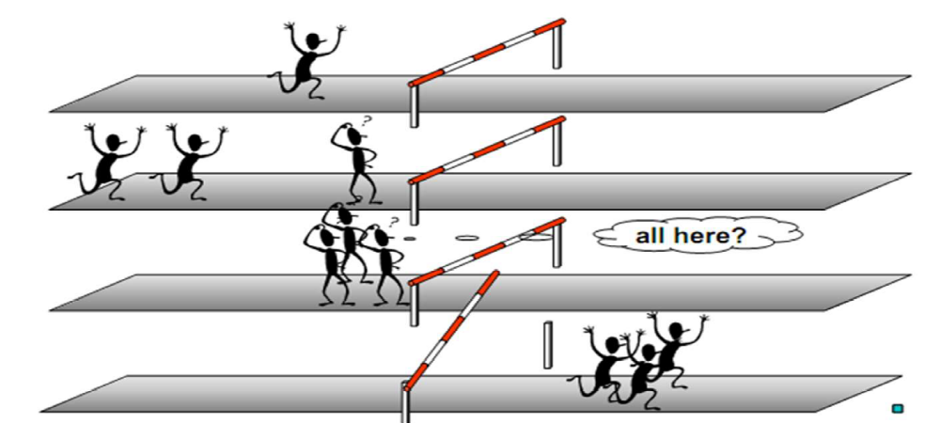
Synchronization: Barrier Directive
Synchronizes all the threads in a team

Slide 14
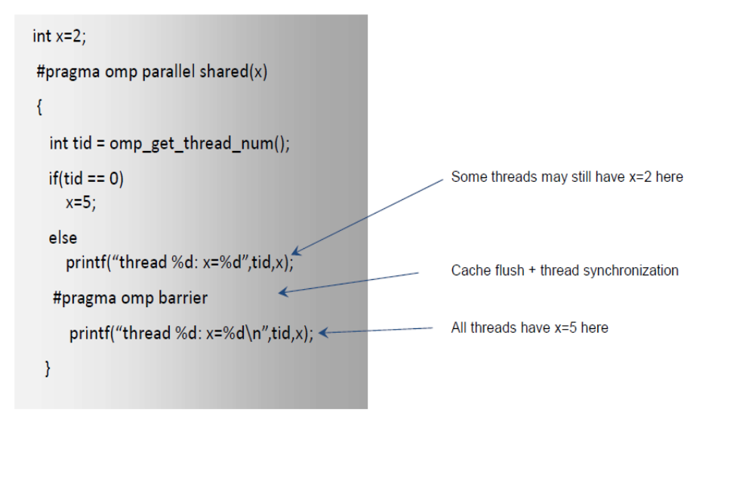
Synchronization: Barrier Directive

Slide 15
When to Use Barriers
If data is updated asynchronously and data integrity is at risk .
Examples:
–Between parts in the code that read and write the same section of memory
–After one timestep/iteration in a numerical solver
Barriers are expensive and also may not scale to a large number of processors

Slide 16
OpenMP Runtime System
Each #pragma omp parallel creates a team of threads, which exist as long as the following block executes
  #pragma omp for and #pragma omp section must be placed dynamically within a #pragma omp parallel.
  Optimization: If there are several #pragma omp for and/or #pragma omp section within the same parallel, the threads will not be destroyed and created again
Problem: a #pragma omp for is not permitted within a dynamic extent of another #pragma omp for
  Must include the inner #pragma omp for within its own #pragma omp parallel
  Nested parallelism?
  The effect is implementation-dependent (will it create a new set of threads?)

Slide 17
Controlling OpenMP behavior
omp_set_dynamic(int)/omp_get_dynamic()
  Allows the implementation to adjust the number of threads dynamically
omp_set_num_threads(int)/omp_get_num_threads()
  Control the number of threads used for parallelization (maximum in case of dynamic adjustment)
  Must be called from sequential code
  Also can be set by OMP_NUM_THREADS environment variable
omp_get_num_procs()
  How many processors are currently available?
omp_get_thread_num()
omp_set_nested(int)/omp_get_nested()
  Enable nested parallelism
omp_in_parallel()
  Am I currently running in parallel mode?
omp_get_wtime()
  A portable way to compute wall clock time

Slide 18
Synchronization: Lock routines
A lock implies a memory fence of all thread visible variables.
These routines are used to guarantee that only one thread accesses a variable at a time to avoid race conditions.
C/C++ lock variables must have type “omp_lock_t” or “omp_nest_lock_t”.
All lock functions require an argument that has a pointer to omp_lock_t or omp_nest_lock_t.
Simple Lock routines:
–Simple Lock routines: available if it is unset.
– omp_init_lock(), omp_set_lock(),
--omp_unset_lock(), omp_test_lock(),
--omp_destroy_lock()

Slide 19
Synchronization: Lock routines
Nested Locks: available if it is unset or if it is set but owned by the thread executing the nested lock function
omp_init_nest_lock(), omp_set_nest_lock(),
omp_unset_nest_lock(), omp_test_nest_lock(),
omp_destroy_nest_lock()

Slide 20
General Procedure to Use Locks
Define the lock variables .
Initialize the lock via a call to omp_init_lock
Set the lock using omp_set_lock or omp_test_lock. The latter checks whether the lock is actually available before attempting to set it. It is useful to achieve asynchronous thread execution.
Unset a lock after the work is done via a call to omp_unset_lock.
Remove the lock association via a call to omp_destroy_lock.

Slide 21
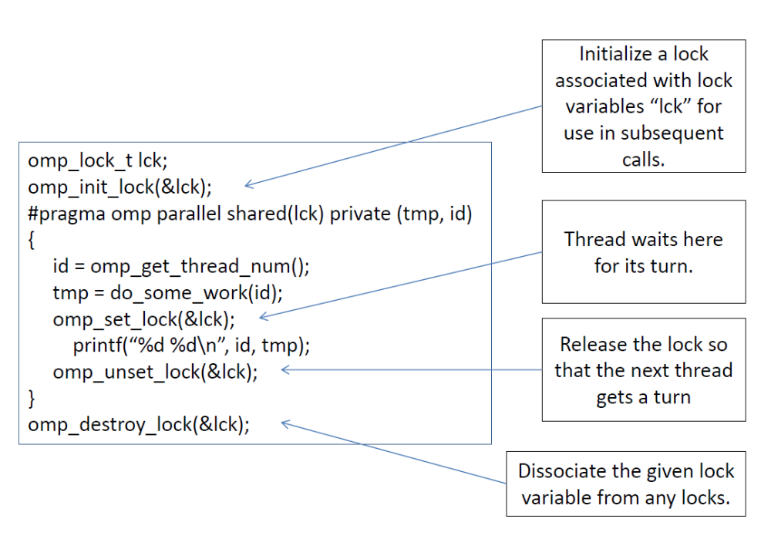

Slide 22
nowait Clause
#pragma omp parallel nowait
By default there is implicit barrier at the end of parallel region
Allows threads that finish earlier to proceed without waiting
If specified, then threads do not synchronize at the end of parallel loop

